Slide 1
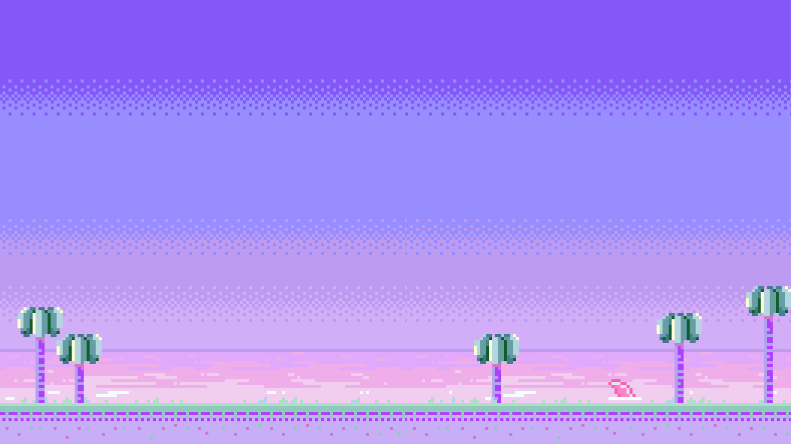







The Forest of Food
Team Gathering
Sieun Choi(Producer)
Hyeonseo Yoon(Lead Designer)
Minjae Kyung(Technical Director)

Slide 2




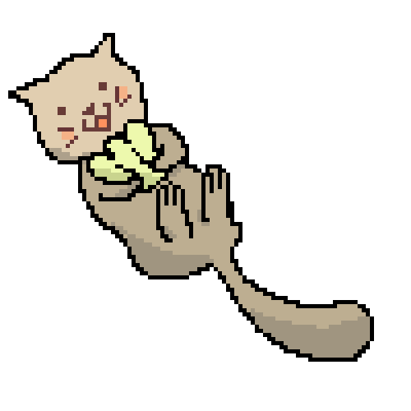


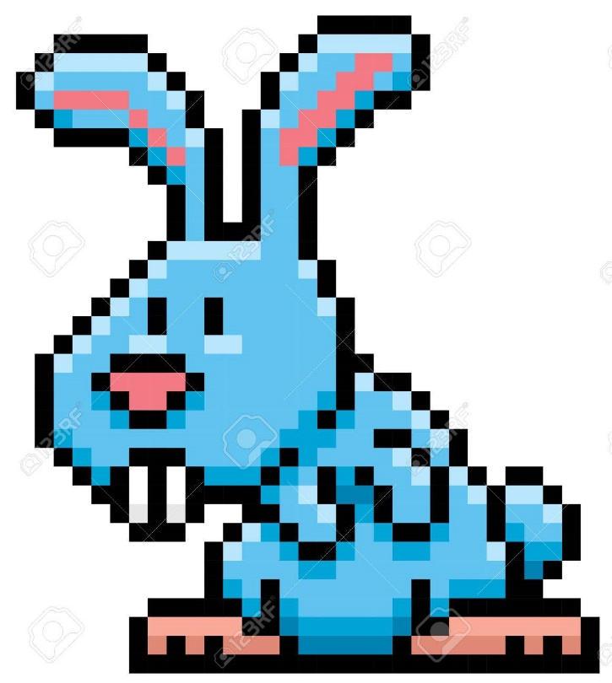



Team Introduction
Producer
Lead Designer
Technical Director
Sieun Choi
Hyeonseo Yoon
Minjae Kyung

Slide 3


The Forest of Food
High Concept
Top - view adventure.
Find ingredients of food on ‘The Forest of Food’
to make seasonal food.
Notes:
Our Game, the forest of food, is top view adventure game.
it's objective is to find ingredients of food on the forest of
food to make seasonal food

Slide 4




Summary

Slide 5



Story
Notes:
Our game's story is about a person spent a lot of
money to buy video games on steam

Slide 6


Story
Notes:
As he spend most of money, he have no money
to buy some food. So he is about to die.

Slide 7

Story
Notes:
At that moment, suddenly fairy of Forest of food is appear
to him and suggest that he will bring him to the forest
of food that has many food.

Slide 8



Story
Notes:
He accepted it, and he teleported to forest and He can satisfy his hunger.
but He cannot back to home because fairy want to repay his favor
so he have to make some food for fairy

Slide 9

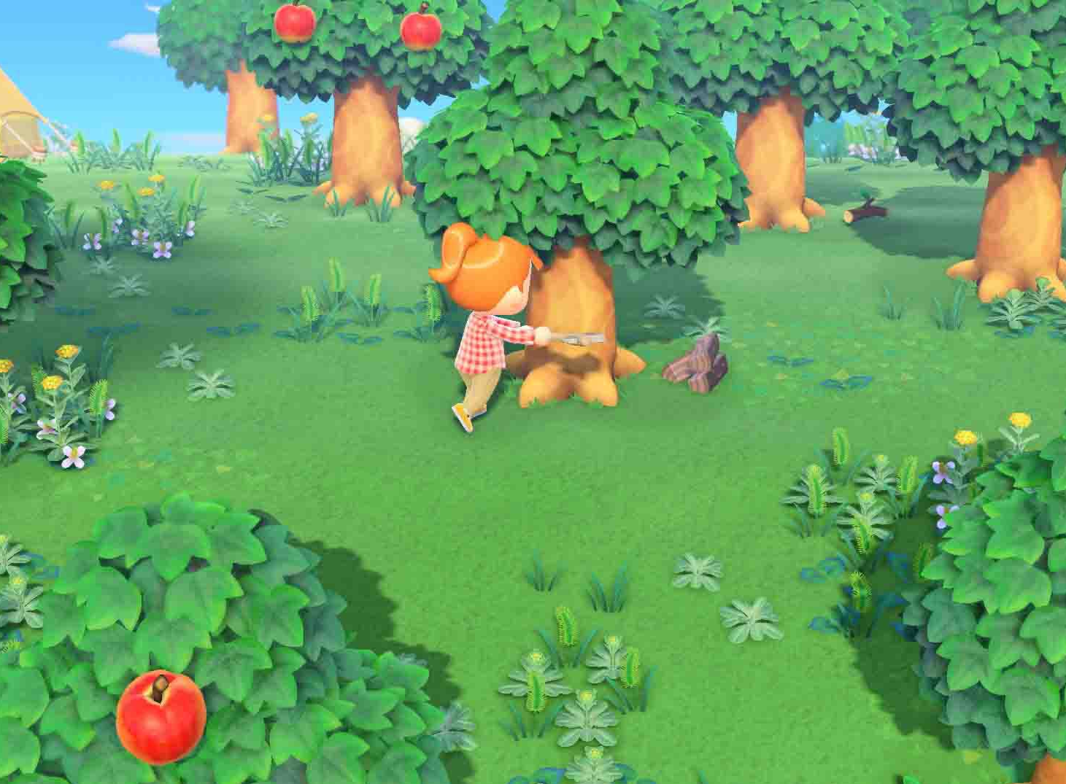
Mechanic
Explore the map
Find ingredients
Hunt animals
Make foods to satisfy fairy
If you don’t satisfy him, you will trap in forest
Mainly inspired by animal a crossing
Notes:
Our main game mechanic is (3개) and our main mechanic
and mood is mainly inspired by Animal crossing,
So our game will be peaceful game

Slide 10




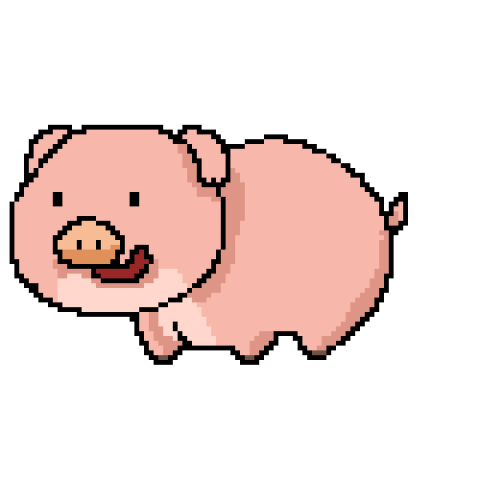
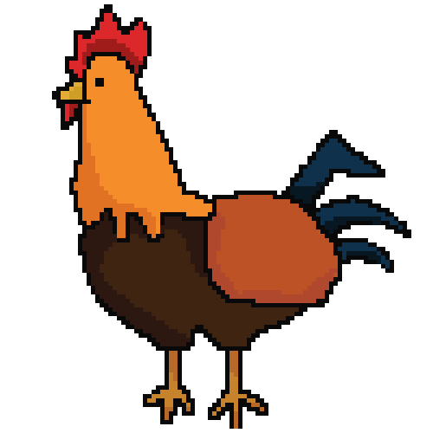
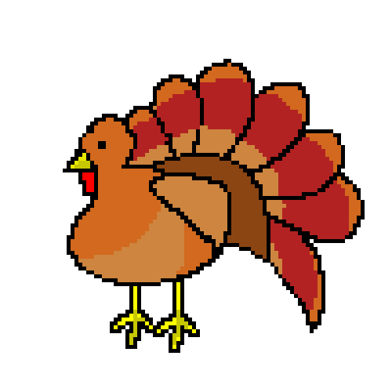
Characters
Notes:
Let me introduce the characters that appear in the game.
The first character to introduce is the main character.
The name of the main character can be determined by the person playing the game.
The main thing about the main character is to make delicious food
for the fairy and go back home.
Therefore the main character can kill animals and collect materials.
The next character is the fairy. The fairy is role of tasting
and evaluating the main character’s food.
The other characters are 4 animals. Cow, chicken, turkey, pig.
Killing these animals will drop the meat of each animal.
Cows appear only in spring, chickens only in summer, turkeys only in fall,
and pigs only in winter.

Slide 11
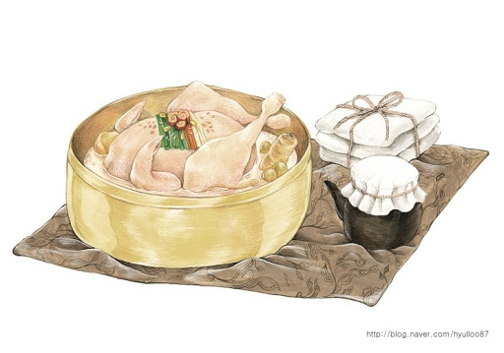
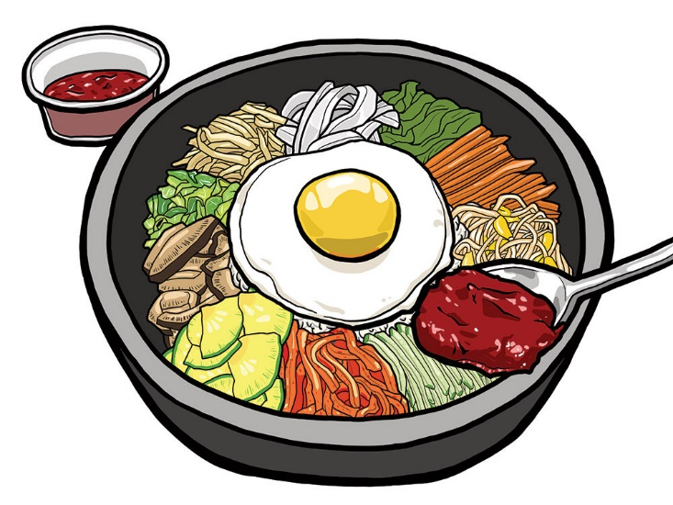
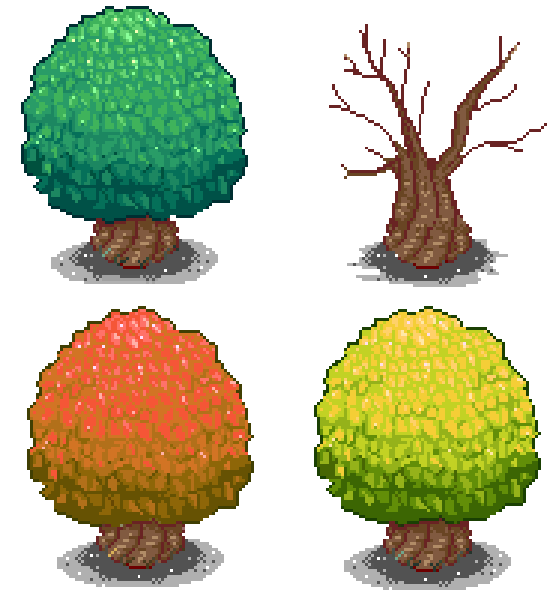
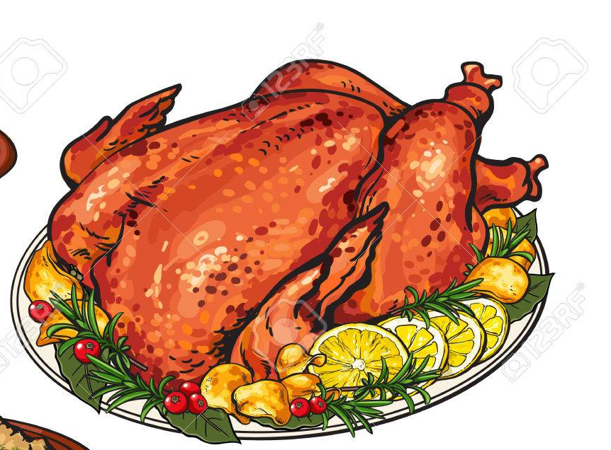
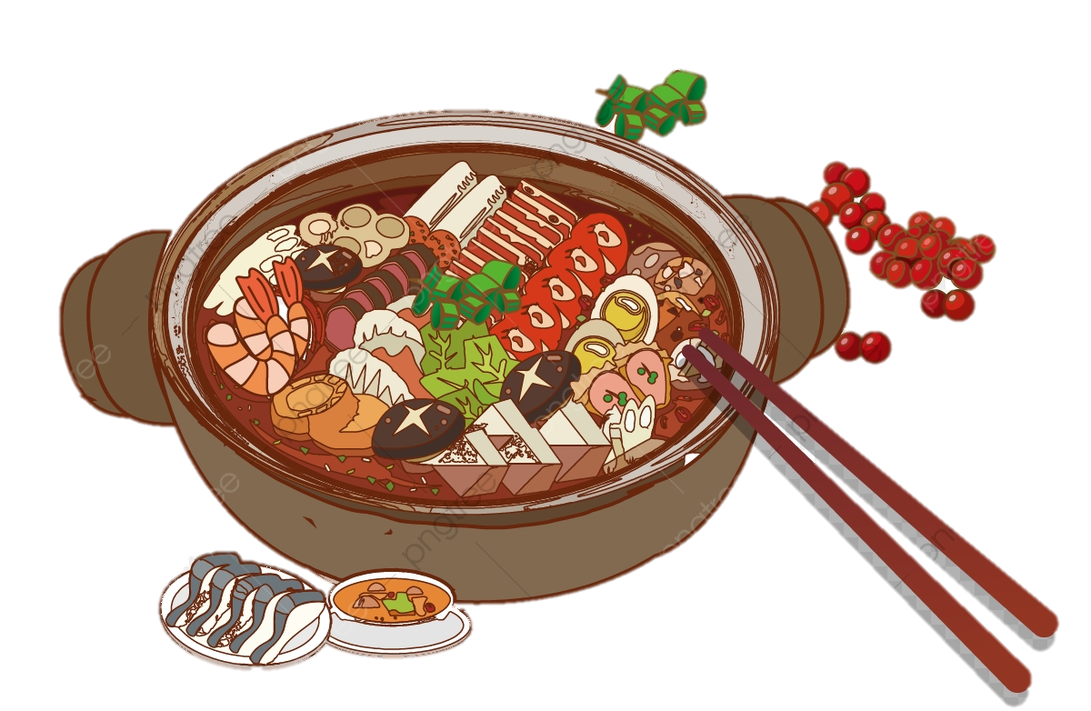
Environments
Spring
Summer
Fall
Winter
Notes:
Next, I will introduce the environments. The game has big one maps,
however The map changes depending on the food you choose.
If you choose “Bom Namul Bibimbap”, the map is set to Spring.
If you choose “Samgyetang”, the map is set to Summer.
If you choose “Grilled Turkey”, the map is set to Fall
and If you choose “Jeongol”, the map is set to Winter.

Slide 12

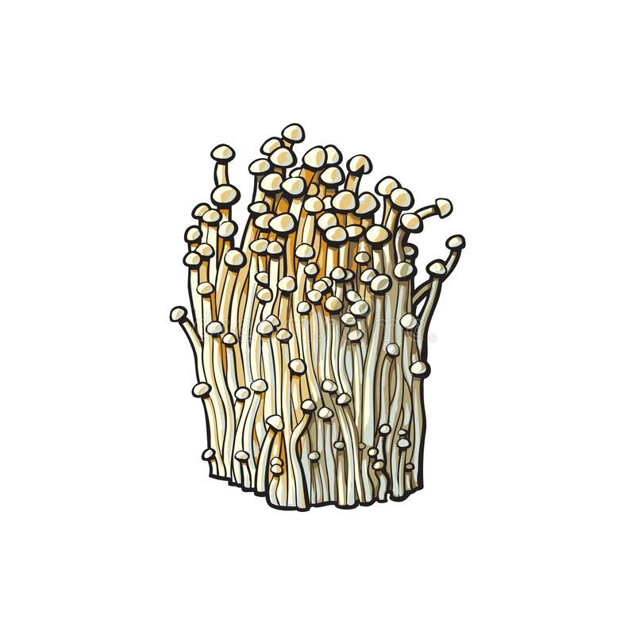
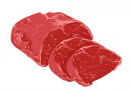

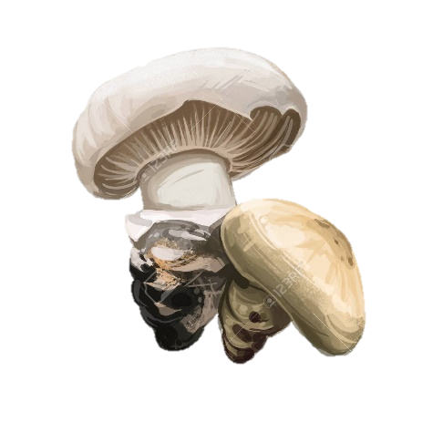


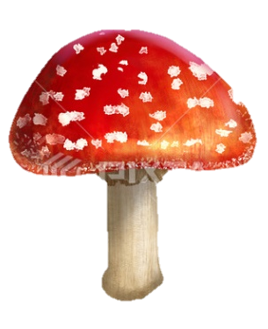
Notes:
I think most important thing about the game is choosing.
Let me give you an example of why. If I had to make “Jeongol”,
I had to pick out these materials. However what
if I picked a poisonous mushroom without picking a normal mushroom?
Or if I didn’t choose one of these? As such, you can see a bad ending
or happy ending with this choice. Therefore, I think the choice is important in the game.

Slide 13

ESRB Ratings
Notes:
Our game is adventure and peaceful game. No violence and maybe no blood
in our game. So our game ESRB ratings is E+10.

Slide 14


Target Audience
Notes:
Recently, there are many adults play healing game. Like Animal Acrossing.
Also Our target audience adults who like healing and adventure game.

Slide 15

Risks And Mitigation
Notes:
Our game is peaceful game. So who dislike peaceful mood may
feel boring because it just collect ingredients on time.
And another risk is our game has ending.
It means that player don't have to play several times.
So we set the time to collect the ingredients to make player tense.
And then we make 4 choices for player.
Like player can choose spring,summer,fall,winter! So there are more chance to play game.

Slide 16







